Slide 1
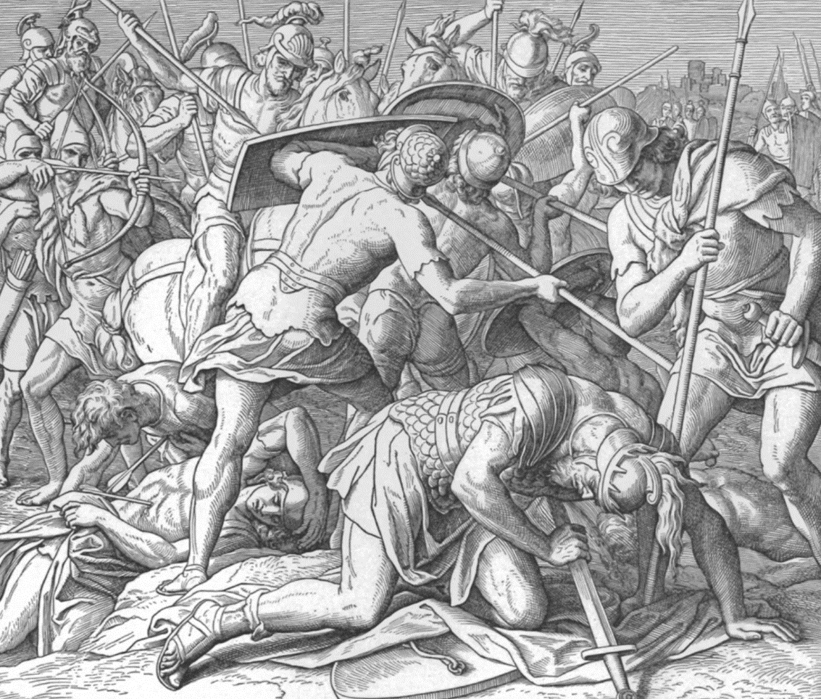
LOSS:
Saul’s Death
1 Samuel 31

Slide 2
Hebrews 9:27 And as it is appointed unto men once to die, but after this the judgment:

Slide 3

Saul lost his sons.
Saul saw three of his sons die. God told him through Samuel.
Neither Saul’s son Ishbosheth nor his general Abner were killed in this battle.
Picture. Jonathon: why wasn’t he WITH David? He was in the WRONG battle.
This is a picture of believers that are too tied up with the wrong people doing the wrong things versus being completely tied up with Christ. The result? Jonathan didn’t get to “reign” with David.

Slide 4
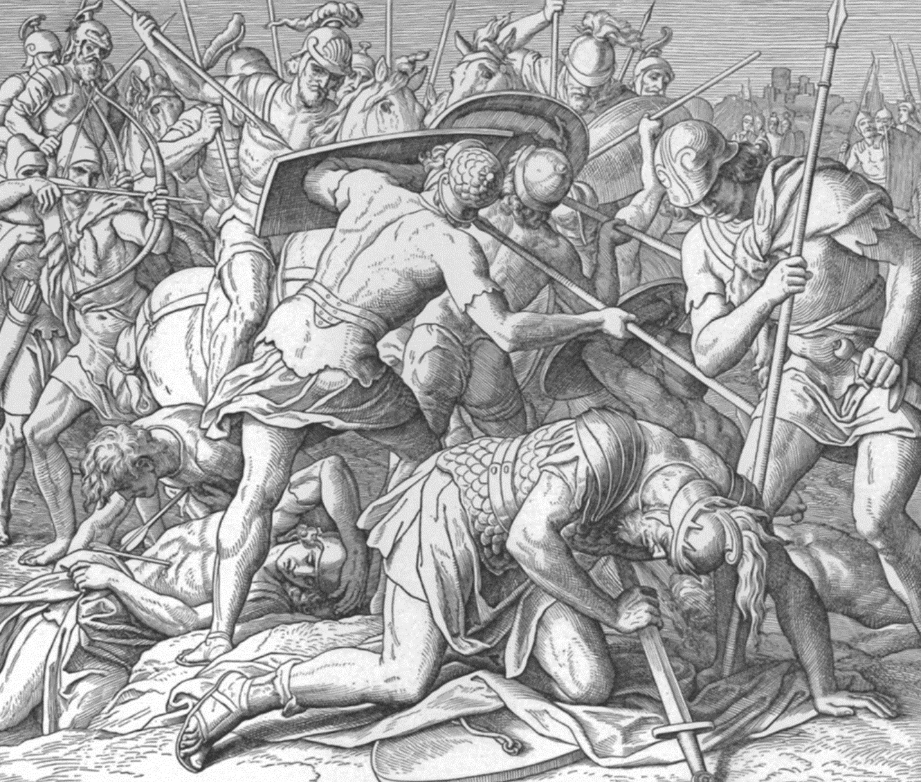
Saul lost the battle.
Notice the parallel between the house of Eli and Saul.
  Both “ruled” about 40 years.

Slide 5
1 Samuel 4:18 And it came to pass, when he made mention of the ark of God, that he fell from off the seat backward by the side of the gate, and his neck brake, and he died: for he was an old man, and heavy. And he had judged Israel forty years.
Acts 13:20-21 And after that he gave unto them judges about the space of four hundred and fifty years, until Samuel the prophet. 21 And afterward they desired a king: and God gave unto them Saul the son of Cis, a man of the tribe of Benjamin, by the space of forty years.

Slide 6
Saul lost the battle.
Notice the parallel between the house of Eli and Saul.
  Both “ruled” about 40 years.
  Both perverted justice.

Slide 7
1 Samuel 3:13 For I have told him that I will judge his house for ever for the iniquity which he knoweth; because his sons made themselves vile, and he restrained them not.
1 Samuel 15:22-23 22 And Samuel said, Hath the LORD as great delight in burnt offerings and sacrifices, as in obeying the voice of the LORD? Behold, to obey is better than sacrifice, and to hearken than the fat of rams. 23 For rebellion is as the sin of witchcraft, and stubbornness is as iniquity and idolatry. Because thou hast rejected the word of the LORD, he hath also rejected thee from being king.

Slide 8
Saul lost the battle.
Notice the parallel between the house of Eli and Saul.
  Both “ruled” about 40 years.
  Both perverted justice.
  Both “fell.” Eli fell off his seat. Saul fell on his sword.

Slide 9

Saul lost his life.
The picture in the suicide? A type of antichrist. Note Judas’ suicide.

Slide 10
Matthew 27:3-5 Then Judas, which had betrayed him, when he saw that he was condemned, repented himself, and brought again the thirty pieces of silver to the chief priests and elders, 4 Saying, I have sinned in that I have betrayed the innocent blood. And they said, What is that to us? see thou to that. 5 And he cast down the pieces of silver in the temple, and departed, and went and hanged himself.

Slide 11
Acts 1:16-20 Men and brethren, this scripture must needs have been fulfilled, which the Holy Ghost by the mouth of David spake before concerning Judas, which was guide to them that took Jesus. 17 For he was numbered with us, and had obtained part of this ministry. 18 Now this man purchased a field with the reward of iniquity; and falling headlong, he burst asunder in the midst, and all his bowels gushed out. 19 And it was known unto all the dwellers at Jerusalem; insomuch as that field is called in their proper tongue, Aceldama, that is to say, The field of blood. 20 For it is written in the book of Psalms, Let his habitation be desolate, and let no man dwell therein: and his bishoprick let another take.

Slide 12
1 Chronicles 10:13-14 So Saul died for his transgression which he committed against the LORD, even against the word of the LORD, which he kept not, and also for asking counsel of one that had a familiar spirit, to enquire of it; 14 And enquired not of the LORD: therefore he slew him, and turned the kingdom unto David the son of Jesse.

Slide 13
1 Samuel 10:6 And the Spirit of the LORD will come upon thee, and thou shalt prophesy with them, and shalt be turned into another man.
1 Samuel 10:9-10 And it was so, that when he had turned his back to go from Samuel, God gave him another heart: and all those signs came to pass that day. 10 And when they came thither to the hill, behold, a company of prophets met him; and the Spirit of God came upon him, and he prophesied among them.

Slide 14
1 Samuel 16:14 But the Spirit of the LORD departed from Saul, and an evil spirit from the LORD troubled him.
1 Samuel 28:19 Moreover the LORD will also deliver Israel with thee into the hand of the Philistines: and to morrow shalt thou and thy sons be with me: the LORD also shall deliver the host of Israel into the hand of the Philistines.

Slide 15
Luke 16:22-26 And it came to pass, that the beggar died, and was carried by the angels into Abraham's bosom: the rich man also died, and was buried; 23 And in hell he lift up his eyes, being in torments, and seeth Abraham afar off, and Lazarus in his bosom. 24 And he cried and said, Father Abraham, have mercy on me, and send Lazarus, that he may dip the tip of his finger in water, and cool my tongue; for I am tormented in this flame. 25 But Abraham said, Son, remember that thou in thy lifetime receivedst thy good things, and likewise Lazarus evil things: but now he is comforted, and thou art tormented. 26 And beside all this, between us and you there is a great gulf fixed: so that they which would pass from hence to you cannot; neither can they pass to us, that would come from thence.

Slide 16
Hebrews 11:32 And what shall I more say? for the time would fail me to tell of Gedeon, and of Barak, and of Samson, and of Jephthae; of David also, and Samuel, and of the prophets:
Genesis 18:25 That be far from thee to do after this manner, to slay the righteous with the wicked: and that the righteous should be as the wicked, that be far from thee: Shall not the Judge of all the earth do right?

Slide 17
You never see Saul repent of his evil pursuit.

Slide 18
1 Samuel 8:18 And ye shall cry out in that day because of your king which ye shall have chosen you; and the LORD will not hear you in that day.

Slide 19
The only thing we learn from history, is that we never learn from history.

Slide 20
Matthew 16:27 For the Son of man shall come in the glory of his Father with his angels; and then he shall reward every man according to his works.

Slide 21

In death, Saul lost his dignity.

Slide 22
1 Chronicles 10:8-10 8 And it came to pass on the morrow, when the Philistines came to strip the slain, that they found Saul and his sons fallen in mount Gilboa. 9 And when they had stripped him, they took his head, and his armour, and sent into the land of the Philistines round about, to carry tidings unto their idols, and to the people. 10 And they put his armour in the house of their gods, and fastened his head in the temple of Dagon.

Slide 23
King Saul, a man after Israel’s heart died under God’s judgment.

Slide 24
1 Chronicles 10:13-14 So Saul died for his transgression which he committed against the LORD, even against the word of the LORD, which he kept not, and also for asking counsel of one that had a familiar spirit, to enquire of it; 14 And enquired not of the LORD: therefore he slew him, and turned the kingdom unto David the son of Jesse.

Slide 25
Saul sowed rebellion
= death.
David sowed submission = reigned as king.

Slide 26
Romans 8:16-18 The Spirit itself beareth witness with our spirit, that we are the children of God: 17 And if children, then heirs; heirs of God, and joint-heirs with Christ; if so be that we suffer with him, that we may be also glorified together. 18 For I reckon that the sufferings of this present time are not worthy to be compared with the glory which shall be revealed in us.

Slide 27
LOSS:
Saul’s Death
1 Samuel 31

